Slide 1


Interactive maps in R with Leaflet
James Lawson, Plant Ecology & Conservation Lab, Macquarie University
August 2019

Slide 2

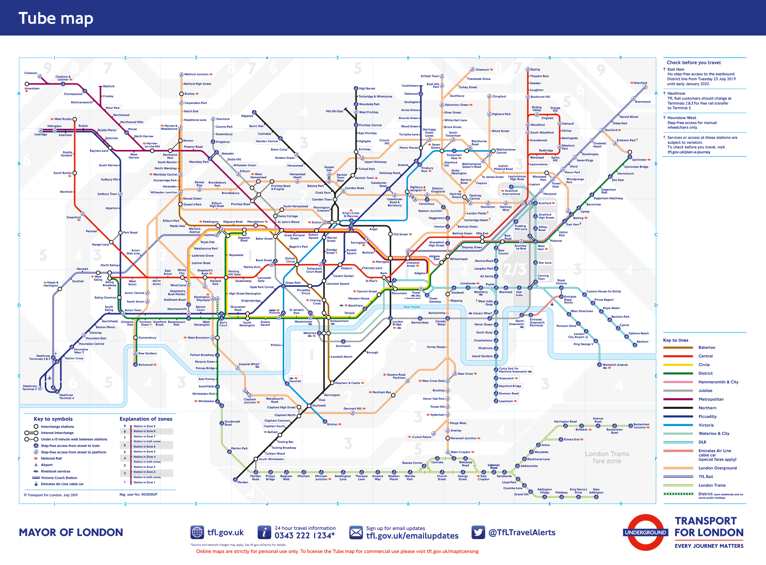
Why do we need better maps?
Since the first maps were transcribed from abstract ideas to concrete documents, they have been largely static.
The more detail static maps describe, the more complicated they are to read.
The 21st century has produced vast swathes of spatial data, but even digitally generated maps still suffer from the same problem.
New technologies for visualising data interactively offer a solution.

Slide 3


What’s a web map?
Enter web maps: using web technology, maps can now encode more data and be simpler to interrogate.
“Web mapping is more than just web cartography, it is a service by which consumers choose what the map will show” – Wikipedia
Zoom, pan, choose features to display, run spatial queries (e.g. ask for directions), interact with map elements, and more. And quickly.

Slide 4
What is Leaflet?
“Leaflet is an open-source Javascript library for mobile-friendly interactive maps”
It pulls together everything you need to present spatial data in a modern web mapping platform.
Leaflet for R contains bindings to Leaflet.JS which allow you to call (almost) all of its functionality from within R.
It’s fun to use, well documented and has many many extensions developed by a great community. And it produces beautiful maps.

Slide 5
A note on Leaflet and Map Projections
Leaflet expects all point, line, and shape data to be specified in latitude and longitude using WGS 84 (a.k.a. EPSG:4326).
By default, when displaying this data it projects everything to Web Mercator (EPSG:3857) and expects that any map tiles are also displayed in EPSG:3857.
For users who need to display data with a different projection, the Proj4Leaflet plugin (in theory) gives Leaflet access to any CRS that is supported by Proj4js.
https://rstudio.github.io/leaflet/projections.html

Slide 6
Leaflet in Shiny apps
Leaflet for R works amazingly with Shiny
Elements in Leaflet maps can be interacted with and used as triggers for Shiny events
Leaflet+Shiny can provide a full spatial data exploration platform

Slide 7
Without further ado we’ll…
See some examples of my work in Leaflet
Make some interactive Leaflet maps in R
Play with Leaflet+Shiny
Check out SoS Site Selector
http://sosss.science.mq.edu.au
Visualisation of earthquakes off Fiji, thanks to Vasudevan Durairaj
https://maddev.shinyapps.io/Earthquake_Visualization/
https://github.com/Maddev25/DDP_CourseProject

